Slide 1
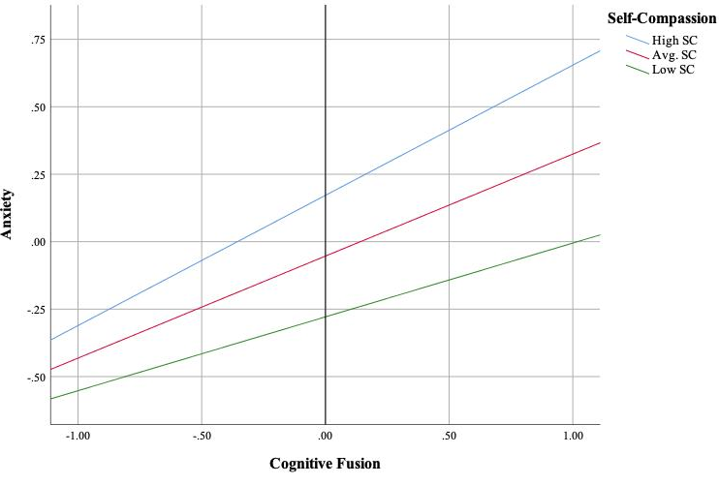
Self-Compassion as a Moderator of the Relationship Between Cognitive Fusion and Anxiety in College Students
Shannon B. Underwood, Eric D. Tifft, Glenn A. Phillips, Emily J. Padula, & John P. Forsyth
Introduction
Results (cont.)
Anxiety is a pervasive problem in their lives of college students, with over 75% reporting significant anxiety and distress (Garlow et al., 2008).
Despite these high rates, just over one-third (36%) of college students reported seeking services over the past year despite having an existing mental health issue (Eisenberg, Hunt, & Speer, 2013).
College students likely are overwhelmed by and subsequently internalizing the stress they face while adjusting to college life.
From an Acceptance and Commitment Therapy (ACT) standpoint, it is widely recognized that cognitive fusion is ubiquitous and harmful.
Individuals overidentify with their thoughts, emotions, and physical states (e.g., “I am just an anxious person and this is how I will always be!”)
Though not formally integrated in the ACT process model, self-compassion is recognized as a protective factor in response to unpleasant emotional states and is associated with psychological health and wellness.
Greater self-compassion is linked with lower anxiety (Neff & Tirch, 2013). This finding is robust.
Furthermore, self-compassion can be utilized as a tool to aid individuals adjusting to stressful life situations (Sbarra, Smith, & Mehl, 2012).
This study seeks to explore the protective nature of self-compassion in relation to cognitive fusion and anxiety in a highly stressed and anxious undergraduate sample.
Figure 1. Levels of Self-Compassion Moderating the Relationship Between Cognitive Fusion and Anxiety Levels.
Methods
Discussion
Participants (N=395) were undergraduates (M_{age} = 18.99, SD_{age} = 2.36) at the University at Albany, SUNY. Participants (69% female) completed a online survey examining the prevalence of meditation and its impact on everyday life.
As part of this larger study, participants completed the following self-report measures:
Beck Anxiety Inventory (BAI; 21 items) to assess anxiety (Beck, Epstein, Brown, & Steer, 1988)
Participants with greater self-compassion reported the lowest levels of anxiety, despite reporting high levels of cognitive fusion.
The highest levels of anxiety were reported by participants with low levels of self-compassion and high levels of cognitive fusion.
These findings support previous work showing that individuals high in self-compassion tend to use just as many negative self-descriptors as individuals low in self-compassion, however; they were less likely to experience anxiety than their peers who were low in self-compassion (Neff, Kirkpatrick, and Rude, 2007).
Together these findings suggest that self-compassion could be utilized as a protective factor to buffer against the harmful effects of cognitive fusion.
The importance of the relational networks that lead to cognitive fusion likely are mitigated by the mindfulness component within self-compassion, as mindfulness allows individuals to recognize painful thoughts, feelings, and emotions without avoidance, overidentification, or judgement.
Future research should examine the unique contributions of individual components of self-compassion on psychological functioning.
Does self-kindness, mindfulness, or a sense of common humanity confer unique roles as protective factors against anxiety and impaired psychological functioning?
Experimental studies isolating these components of self-compassion are needed to clarify how self-compassion functions within the ACT model.
Clinicians should consider introducing self-compassion as a therapeutic process within an ACT framework to promote mindfulness, a self-as-context perspective, and mitigate the negative effects cognitive fusion might have on human suffering associated with anxiety and stress.
Self-Compassion Scale (SCS; 26 items) to evaluate participants’ level of self-compassion measured by six subscales: Self-Kindness, Self-Judgment, Common Humanity, Isolation, Mindfulness, and Over-Identification (Neff, 2003)
The Believability of Anxious Feelings and Thoughts Questionnaire (BAFT; 23 items) to assess participants’ level of cognitive fusion measured by Somatic Concerns, Emotion Regulation, and Negative Evaluation (Herzberg et al., 2012).
Data was analyzed via linear regression. PROCESS Macro v3.3 for SPSS (Hayes, 2017) was utilized to conduct moderation analyses.
Results
Table 1. Linear Regression Model and Moderation Analyses Predicting Anxiety Scores
Variable | R² | B | SE | β | t
Step 1 | .307 | -1.143*** | .150 |  | -7.617
BAFT |  | 0.02*** | .003 | .385 | 7.935
SCS |  | -0.251*** | .048 | -.251 | -5.184
Step 2 | .318 | -1.176*** | .149 |  | -7.864
BAFT * SCS |  | -0.116** | .044 | -.109 | -2.598
References
Eisenberg, D., Hunt, J., & Speer, N. (2013). Mental health in American colleges and universities: variation across student subgroups and across campuses. The Journal of nervous and mental disease, 201(1), 60-67.
Garlow, S. J., Rosenberg, J., Moore, J. D., Haas, A. P., Koestner, B., Hendin, H., & Nemeroff, C. B. (2008). Depression, desperation, and suicidal ideation in college students: results from the American Foundation for Suicide Prevention College Screening Project at Emory University. Depression and anxiety, 25(6), 482-488.
Hayes, A. F. (2017). Introduction to mediation, moderation, and conditional process analysis: A regression-based approach. Guilford Publications.
Neff, K. D., Kirkpatrick, K., & Rude, S. S. (2007). Self-compassion and its link to adaptive psychological functioning. Journal of Research in Personality, 41, 139-154.
Neff, K., & Tirch, D. (2013). Self-compassion and ACT. Mindfulness, acceptance, and positive psychology: The seven foundations of well-being, 78-106.
Sbarra, D. A., Smith, H. L., & Mehl, M. R. (2012). When leaving your ex, love yourself: Observational ratings of self-compassion predict the course of emotional recovery following marital separation. Psychological Science, 23, 261-269
Note: *p < .05, ** p < .01, ***p < .001

